Slide 1
CS5714 Usability Engineering
An Iterative, Evaluation-Centered Life Cycle For Interaction Development
Copyright © 2003 H. Rex Hartson and Deborah Hix.

Slide 2

Topics
Connections of user interaction development to software engineering
Development activities in the usability engineering life cycle
Usability management
User interface development team
LC
System development
Mobius

Slide 3
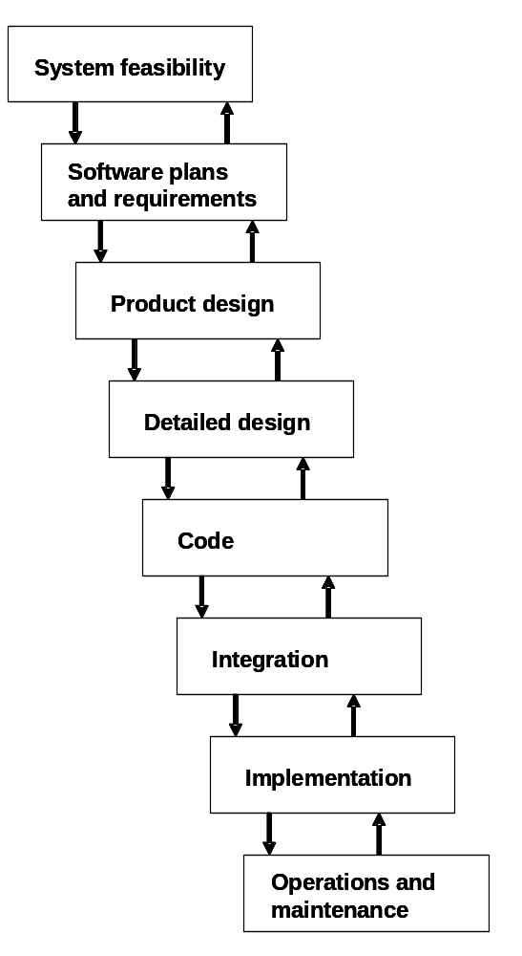
Typical Software Engineering LC
The Waterfall Model
LC

Slide 4
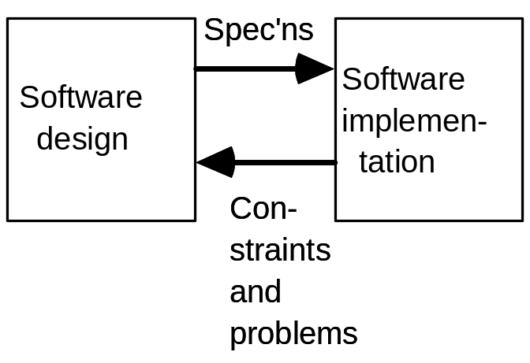
The Process of User Interaction Development
Connections of user interaction development to software engineering
All these figures depict communication paths, not temporal ordering of activities
Distinction between design and implementation
Start with basic software engineering concept:
LC

Slide 5
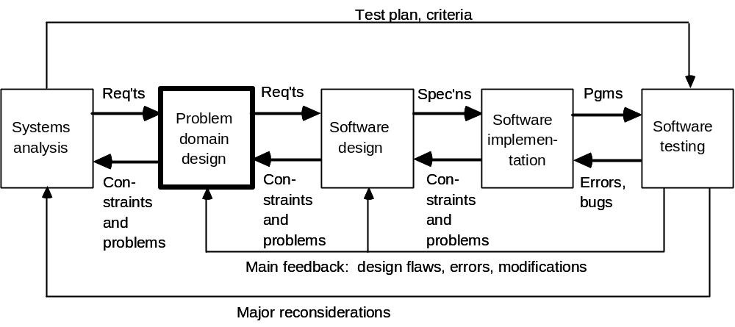
The Process of User Interaction Development
Adding systems analysis, testing, and problem (application) domain
LC

Slide 6
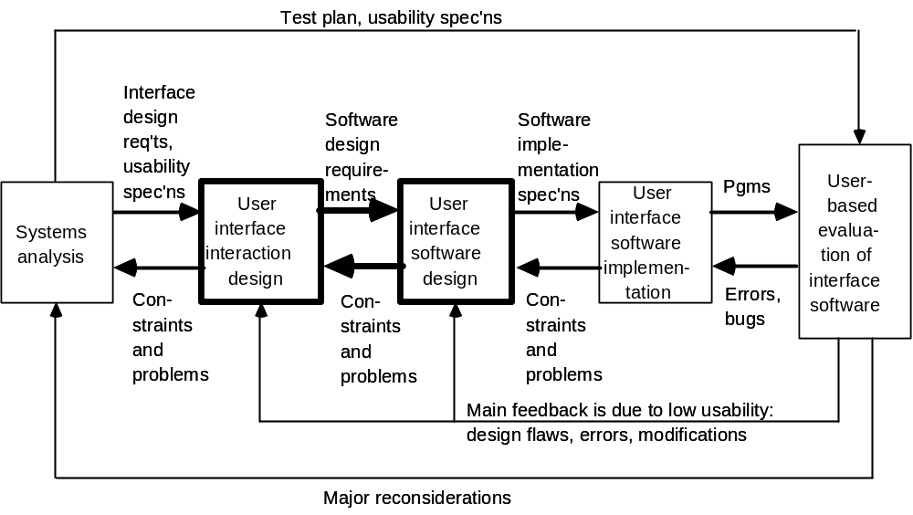
The Process of User Interaction Development
Analogous activities for user interface development
LC

Slide 7
The Process of User Interaction Development
Connecting the processes together and adding rapid prototyping
LC

Slide 8
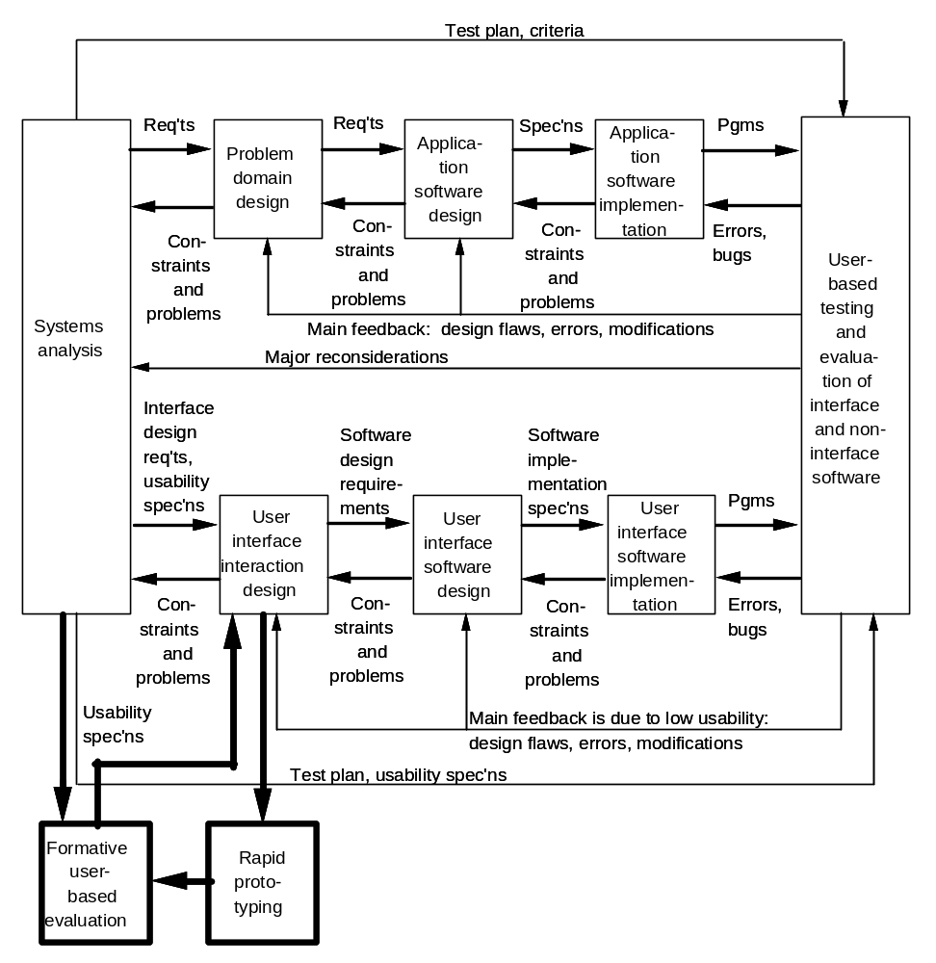
LC

